Slide 1
MINIMUM SPANNING TREES
SUBMITTED BY :- ABHINAV SINGH
ROLL NO. :- 181210001
CSE 2ND YEAR(GROUP – 1)

Slide 2
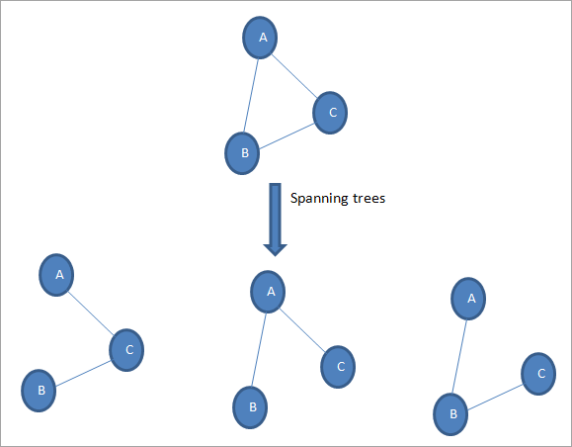
SPANNING TREE :-
SPANNING TREE
A spanning tree of a graph is a subgraph that consists of minimum number of edges so that it can connect all nodes(vertices) of graph.
Here |E| = |V|-1.

Slide 3
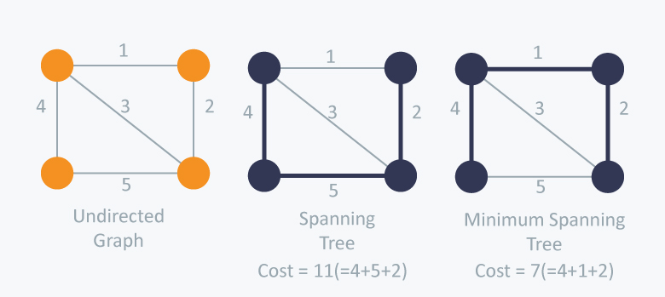
MINIMUM SPANNING TREE :-
MINIMUM SPANNING TREE
For a weighted graph we can get a number of different weights spanning trees.
The spanning tree with minimum cost is called minimum spanning tree.

Slide 4
METHODS TO FIND MINIMUM SPANNING TREE :-
MINIMUM SPANNING TREE
Minimum spanning tree can be achieved through two processes :
1 - BRUTE-FORCE
2 - GREEDY-ALGORITHM :- i) PRIM’S ALGORITHM
ii) KRUSKAL’S ALGORITHM

Slide 5
PRIM’S ALGORITHM :-
MINIMUM SPANNING TREE – PRIM’S ALGORITHM
The idea is to maintain two sets of vertices. The first set contains the vertices already included in the MST, the other set contains the vertices not yet included.
At every step, it considers all the edges that connect the two sets, and picks the minimum weight edge from these edges.
After picking the edge, it moves the other endpoint of the edge to the set containing MST.

Slide 6
ALGORITHM:-
MINIMUM SPANNING TREE – PRIM’S ALGORITHM
MST-PRIM(G,w,r)
for each u є G.V
u.key = ∞
u.π = NIL
r.key = 0
Q = G.V
while Q != ;
u = EXTRACT-MIN(Q)
for each v є G.Adj[u]
if v є Q and w(u,v)< v.key
v. π = u
v.key = w(u,v)

Slide 7
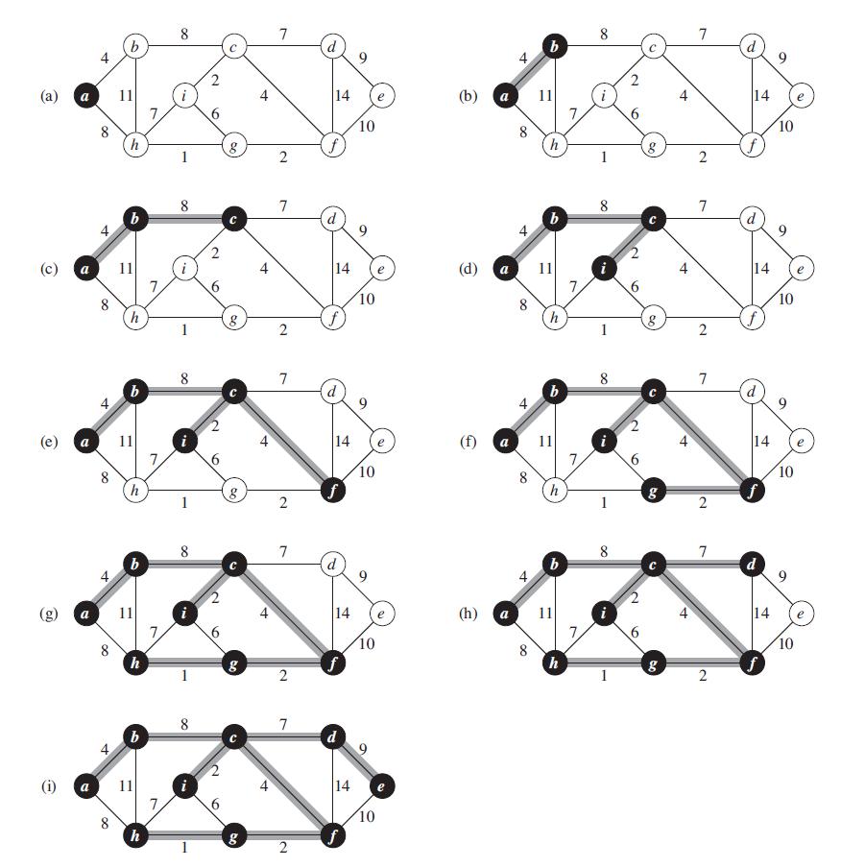
EXAMPLE :-
MINIMUM SPANNING TREE – PRIM’S ALGORITHM

Slide 8
TIME COMPLEXITY :-
MINIMUM SPANNING TREE – PRIM’S ALGORITHM
Here vertex is inserted in the priority queue only once and insertion in priority queue take logarithmic time.
So the time complexity of the Prim’s Algorithm is O((V+E)logV)

Slide 9
KRUSKAL’S ALGORITHM :-
MINIMUM SPANNING TREE – KRUSKAL’S ALGORITHM
Kruskal's algorithm is a minimum-spanning-tree algorithm which finds an edge of the least possible weight that connects any two trees in the forest.
It is a greedy algorithm in graph theory as it finds a minimum spanning tree for a connected weighted graph adding increasing cost arcs at each step.
STEPS :-
Sort the graph edges with respect to their weights.
Start adding edges to the MST from the edge with the smallest weight until the edge of the largest weight.
Only add edges which doesn't form a cycle , edges which connect only disconnected components.
Stop when it contains n-1 edges where n = number of nodes in graph.

Slide 10
ALGORITHM :-
MINIMUM SPANNING TREE – KRUSKAL’S ALGORITHM
MST-KRUSKAL(G,w)
A = ;
for each vertex v є G.V
M AKE-SET(v)
sort the edges of G.E into nondecreasing order by weight w
for each edge (u,v) є G.E, taken in nondecreasing order by weight
if FIND-SET(u) != FIND-SET(v)
A = A U {(u,v)}
UNION(u,v)
return A

Slide 11
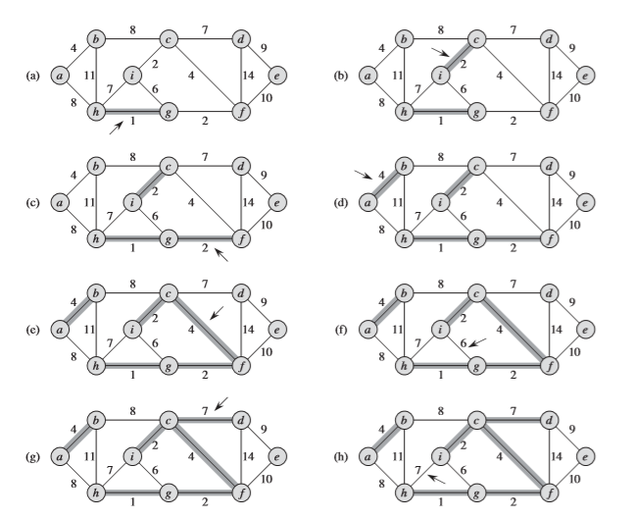
EXAMPLE :-
MINIMUM SPANNING TREE – KRUSKAL’S ALGORITHM

Slide 12
TIME COMPLEXITY :-
MINIMUM SPANNING TREE – KRUSKAL’S ALGORITHM
In Kruskal’s algorithm, most time consuming operation is sorting because the total complexity of the Disjoint-Set operations will be O(ElogV).
which is the overall Time Complexity of the algorithm.

